Slide 1
2 Thessalonians 1:1-12

Slide 2
2 Thessalonians 1:11–2:8 ~ ¹¹ Therefore we also pray always for you that our God would count you worthy of this calling, and fulfill all the good pleasure of His goodness and the work of faith with power, ¹² that the name of our Lord Jesus Christ may be glorified in you, and you in Him, according to the grace of our God and the Lord Jesus Christ.
2:1 Now, brethren, concerning the coming of our Lord Jesus Christ and our gathering
2 Thessalonians 1:1-12

Slide 3
2 Thessalonians 1:11–2:8 ~ together to Him, we ask you, ² not to be soon shaken in mind or troubled, either by spirit or by word or by letter, as if from us, as though the day of Christ had come. ³ Let no one deceive you by any means; for that Day will not come unless the falling away comes first, and the man of sin is revealed, the son of perdition, ⁴ who opposes and exalts himself above all that is called God or that is worshiped, so that he
2 Thessalonians 1:1-12

Slide 4
2 Thessalonians 1:11–2:8 ~ sits as God in the temple of God, showing himself that he is God.
⁵ Do you not remember that when I was still with you I told you these things? ⁶ And now you know what is restraining, that he may be revealed in his own time. ⁷ For the mystery of lawlessness is already at work; only He who now restrains will do so until He is taken out of the way. ⁸ And then the lawless one will be
2 Thessalonians 1:1-12

Slide 5
2 Thessalonians 1:11–2:8 ~ revealed, whom the Lord will consume with the breath of His mouth and destroy with the brightness of His coming.
2 Thessalonians 1:1-12

Slide 6
2 Thessalonians 1:1-12

Slide 7
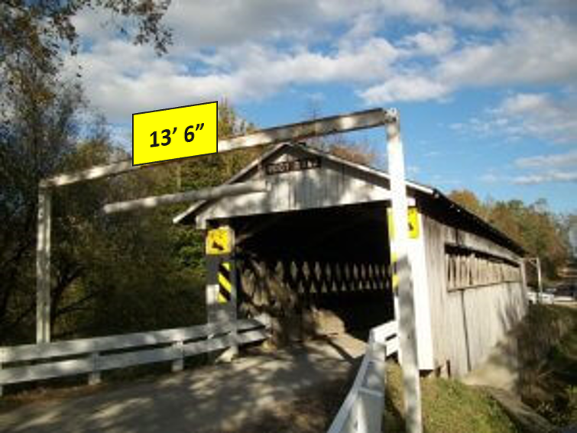
2 Thessalonians 1:1-12

Slide 8
2 Thessalonians 1:1-12

Slide 9
shaken in mind ~ apo tou nous – from the mind
nor by letter ~ i.e. a forgery
2 Thessalonians 1:1-12

Slide 10
2 Thessalonians 1:1-12

Slide 11
falling away ~ apostasia
NASB ~ apostasy, NIV ~ rebellion
apo (away from) + stasis (a place or position)
Acts 21:21 ~ but they have been informed about you that you teach all the Jews who are among the Gentiles to forsake Moses, saying that they ought not to circumcise their children nor to walk according to the customs.
2 Thessalonians 1:1-12

Slide 12
Jerome’s Vulgate ~ discessio – departure
Wycliff (1384)
Tyndale (1526)
Coverdale 1535)
Cranmer (1538)
Breeches Bible (1576)
Beza (1583)
Geneva (1608)
Bishop’s Bible and KJV are the only early English Bibles to render it falling away
2 Thessalonians 1:1-12

Slide 13
Wuest ~ … because that day shall not come except the aforementioned departure [of the Church to heaven] comes first and the man of the lawlessness is disclosed …
2 Thessalonians 1:1-12

Slide 14
2 Thessalonians 1:1-12

Slide 15
man of sin; son of perdition
the Antichrist (1 John 2:18)
the lawless one (2 Thess. 2:8)
the beast (Rev. 11:7)
the little horn (Dan. 7:8)
2 Thessalonians 1:1-12

Slide 16
2 Thessalonians 1:1-12

Slide 17
Types and forerunners:
Alexander the Great (356 BC – 323 BC)
Antiochus Epiphanes (215 BC – 164 BC)
Nero (AD 37 – AD 64)
Other candidates:
Adolph Hitler (1889-1945)
Henry Kissinger (b. 1925)
2 Thessalonians 1:1-12

Slide 18
son of perdition ~ apōleia – from Apollyon (Destroyer)
Also used of Judas (John 17:12)
Antichrist ~ anti means against and before
2 Thessalonians 1:1-12

Slide 19
Dan. 9:26-27 ~ ²⁶ “And after the sixty-two weeks
Messiah shall be cut off, but not for Himself;
And the people of the prince who is to come
Shall destroy the city and the sanctuary.
The end of it shall be with a flood,
And till the end of the war desolations are determined.
2 Thessalonians 1:1-12

Slide 20
Dan. 9:26-27 ~ ²⁷ Then he shall confirm a covenant with many for one week;
But in the middle of the week
He shall bring an end to sacrifice and offering.
And on the wing of abominations shall be one who makes desolate,
Even until the consummation, which is determined,
Is poured out on the desolate.”
2 Thessalonians 1:1-12

Slide 21
Matt. 24:15 ~ “Therefore when you see the ‘abomination of desolation,’ spoken of by Daniel the prophet, standing in the holy place”
2 Thessalonians 1:1-12

Slide 22
2 Thessalonians 1:1-12

Slide 23
6
6
6
Roman
Greek
Babylonian
2 Thessalonians 1:1-12

Slide 24
6
6
6
2 Thessalonians 1:1-12

Slide 25
S
C
O
T
T
A=1
B=2
C=3
D=4, ect.
3+
21+
14+
14
1
19+
=7
-1=
6
6
6
2 Thessalonians 1:1-12

Slide 26
2 Thessalonians 1:1-12

Slide 27
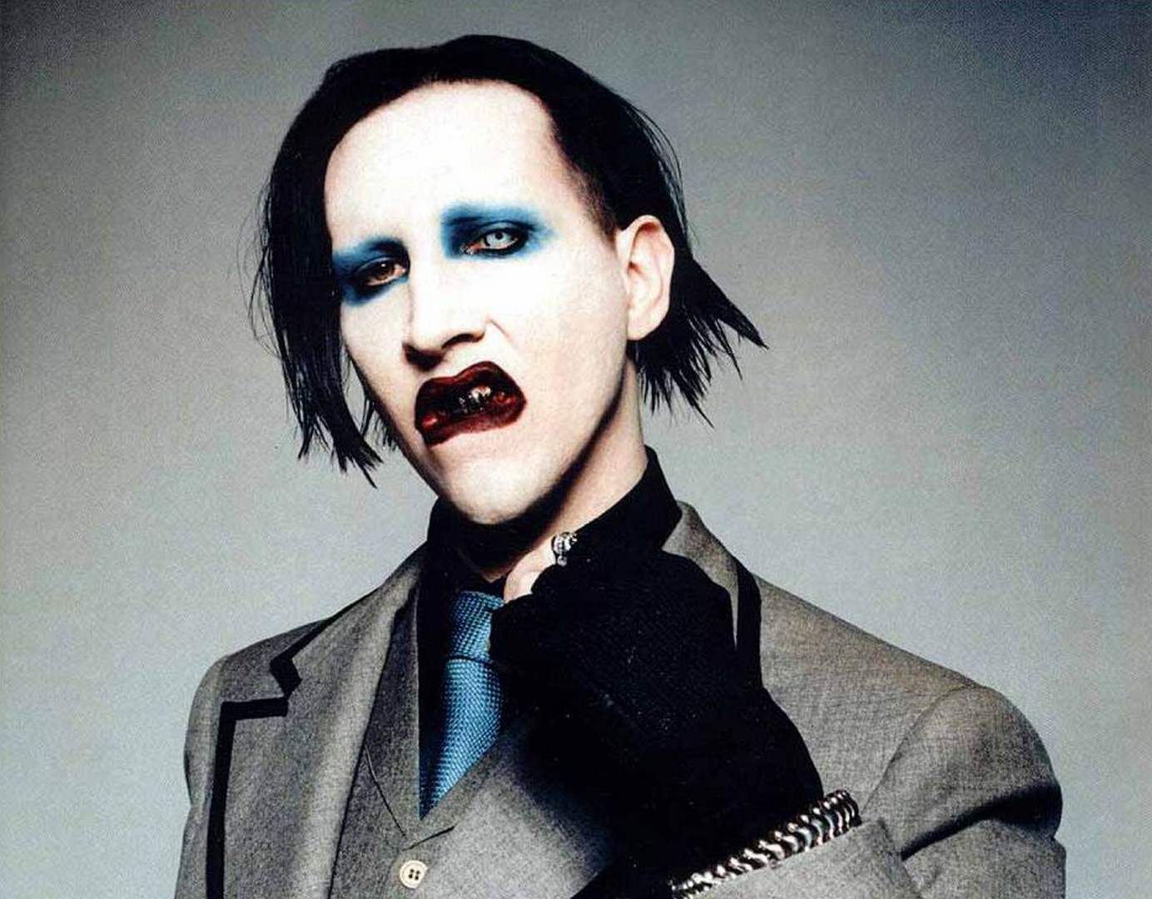
Marilyn Manson ~ “But through years of myth-making and fear-sowing, Christianity meta-morphosed antichrists into a single Antichrist an apocalyptic villain
and Christian bogeyman
used to scare people as
much as Santa Claus is
used to regulate children’s
behavior.”
2 Thessalonians 1:1-12

Slide 28
2 Thessalonians 1:1-12

Slide 29
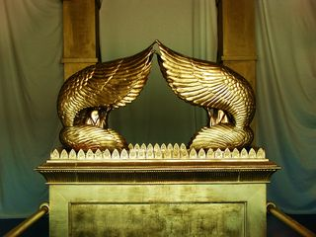
Presence of God
2 Thessalonians 1:1-12

Slide 30
1 Cor. 3:16 ~ Do you not know that you are the temple of God and that the Spirit of God dwells in you (plural)?
2 Thessalonians 1:1-12

Slide 31
2 Thessalonians 1:1-12

Slide 32
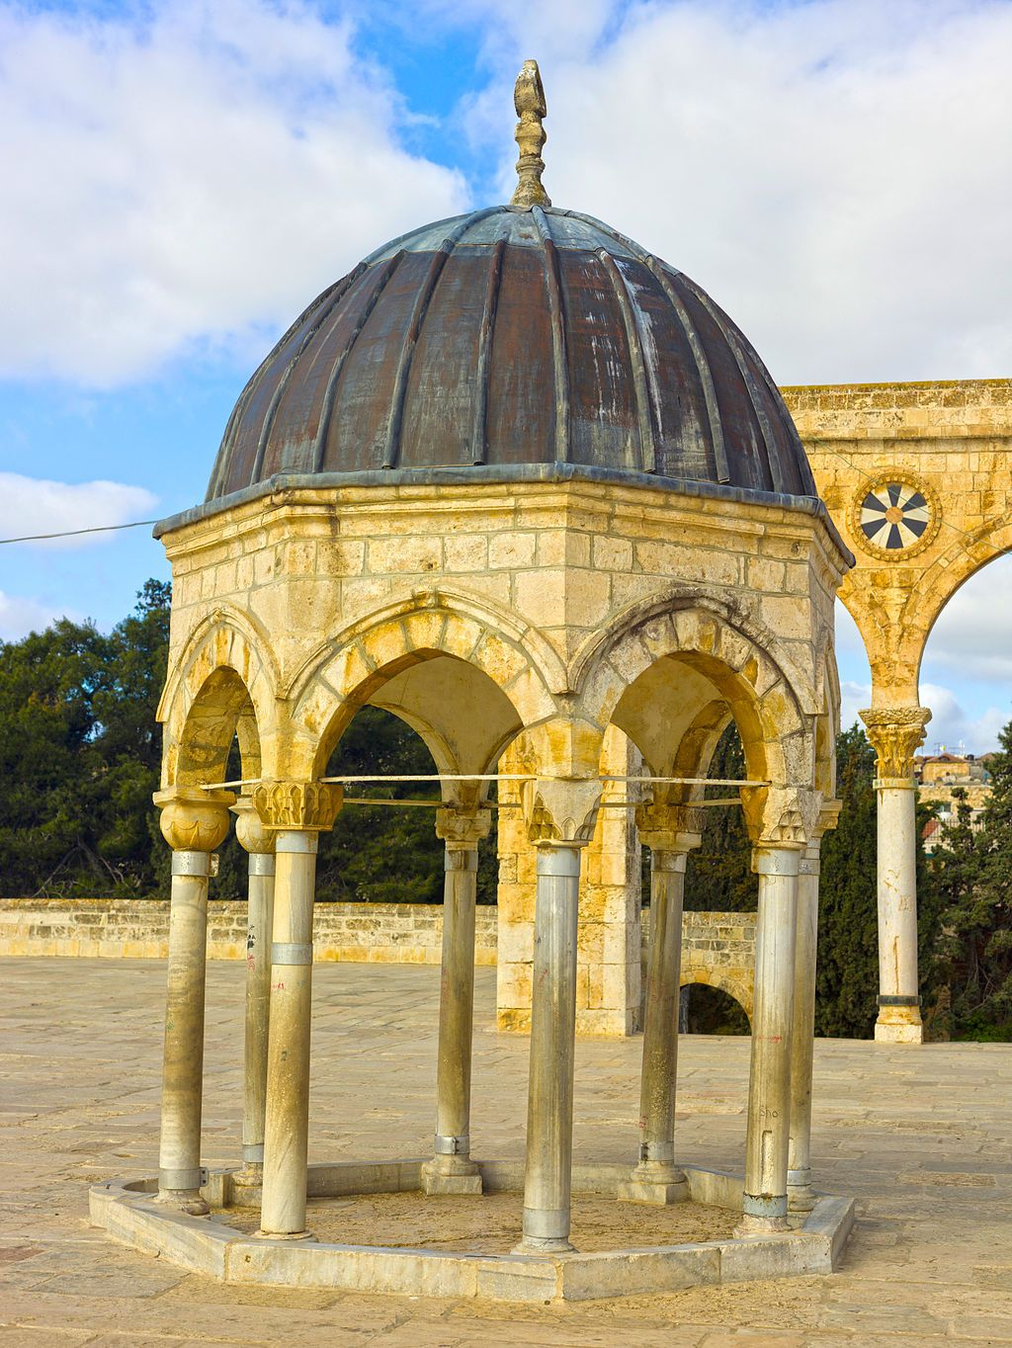
Temple Mount
al-Aqsa Mosque
Dome of the Rock
Dome of the Spirits
2 Thessalonians 1:1-12

Slide 33
Rev. 11:1-2a ~ ¹ Then I was given a reed like a measuring rod. And the angel stood, saying, “Rise and measure the temple of God, the altar, and those who worship there. ^{2a} But leave out the court which is outside the temple, and do not measure it, for it has been given to the Gentiles.
2 Thessalonians 1:1-12

Slide 34
Rapture
Eze. 38-39 War
Abomination of Desolation
Church Age
Tribulation
Millennium
Rise of Antichrist
7-year peace treaty
2 Thessalonians 1:1-12

Slide 35
2 Thessalonians 1:1-12

Slide 36
Destroy ~ katargeō – render powerless
The Antichrist will be one bad dud
e
2 Thessalonians 1:1-12

Slide 37
2 Thessalonians 1:1-12

